Slide 1
Ultra-Short Introduction to Computer Graphics and Visualisation
ACSE-5: Lecture 10
Adriana Paluszny
Royal Society University Research Fellow

Slide 2
Overview
What is Computer Graphics?
What areas does it influence?
Why should we know about it?

Slide 3
Why computer graphics?
Makes thing visible
It is Everywhere
Visual systems must
deal with Parallel input and must produce Parallel output
Computer graphics: key for human-computer communication

Slide 4

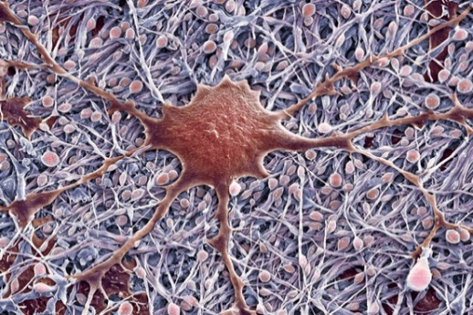
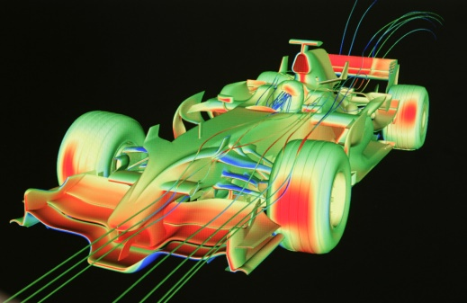
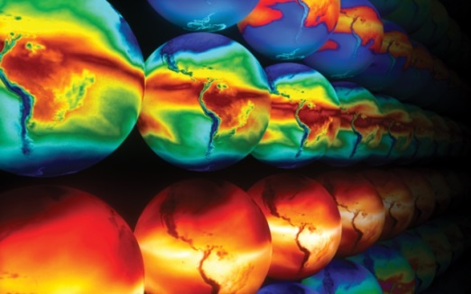
Why visualization?
Visualization or visualisation (see spelling differences) is any technique for creating images, diagrams, or animations to communicate a message. [Wikipedia]
MEDICINE
Biology
Computer graphics are pictures and films created using computers. Usually, the term refers to computer-generated image data created with the help of specialized graphical hardware and software. [Wikipedia]
Engineering
EARTH SCIENCES
VISUAL KNOWLEDGE DISCOVERY make sense of mountains of data
[Bruckner]

Slide 5

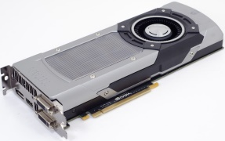
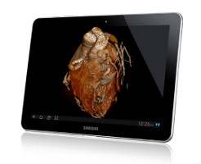
Aim of visualisation
Enable visual knowledge discovery in large spatial data collections
1
Effective Navigation in Spatial Data Collections
GENERAL METHODOLOGY
ALGORITHMIC SOLUTIONS
TECHNICAL FRAMEWORK
2
Real-Time Visualization of Large Datasets
3
Distributed Collaboration and Communication
[Bruckner]

Slide 6
Applications
Graphs and charts
Computer-Aided Design
Virtual Reality
Data Visualization
Education and training
Computer Art
Movies
Games
Graphical User Interfaces

Slide 7
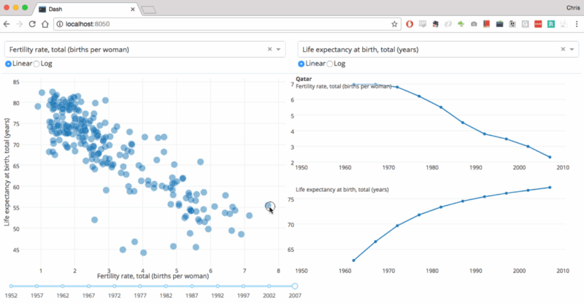
Business graphics

Slide 8
Infographics / Information Visualisation
https://www.axios.com/

Slide 9
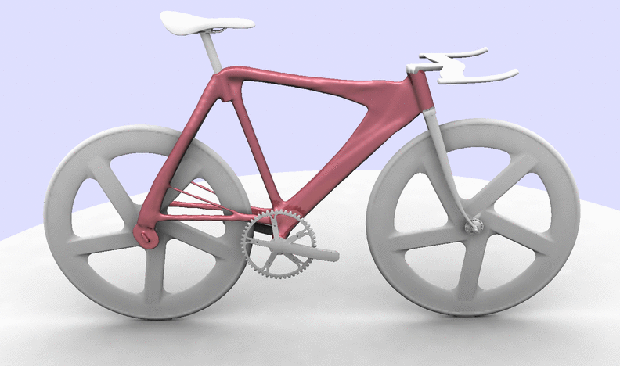
Computer-Aided Design
AutoDesk
AutoCAD
Rhinoceros
And many others
https://autodeskresearch.com

Slide 10
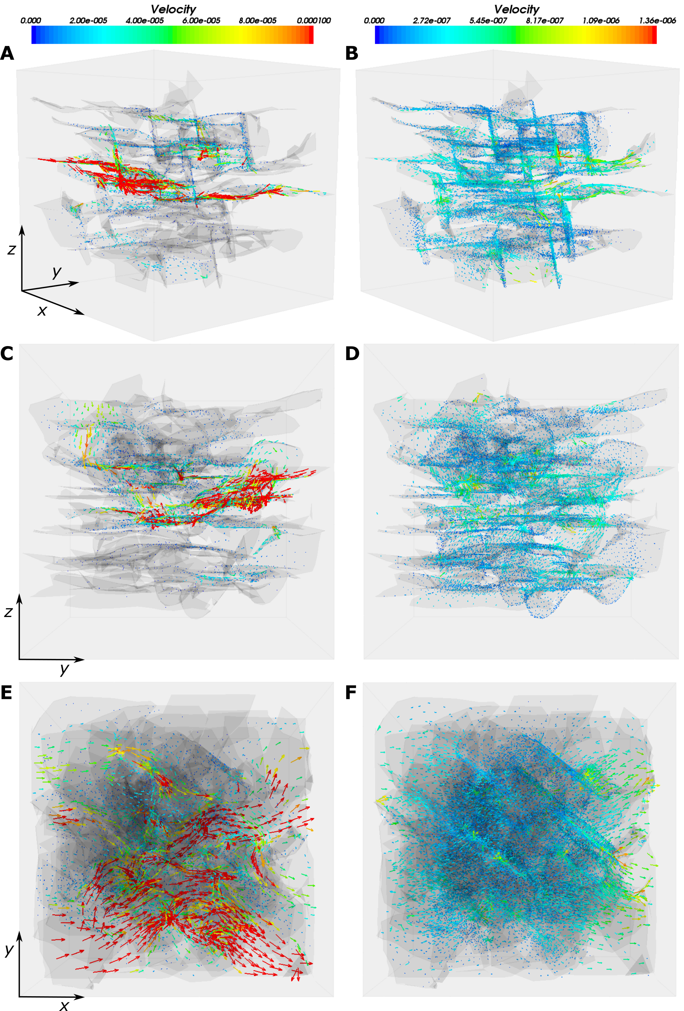
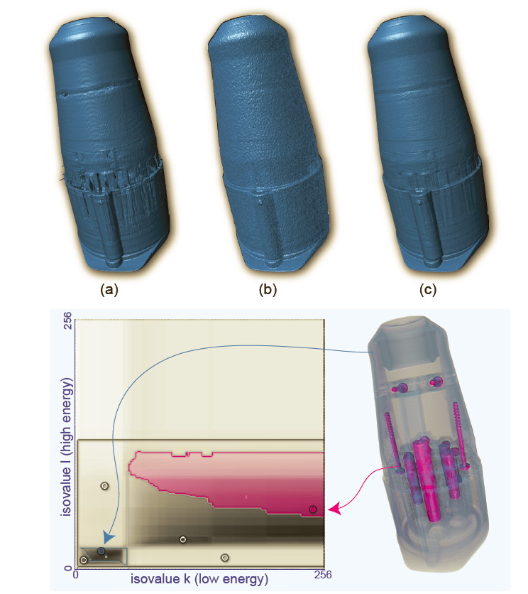
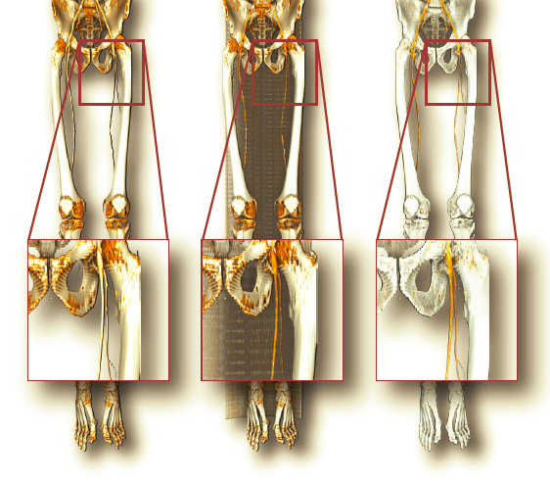
Virtual 3D domains
removing artifacts in industrial CT
delineating blood vessels in angiography
Thomas 2019
Bruckner, Bergen University 2019
understanding flow in the subsurface

Slide 11

Movies
expression
depth of field
fracture
motion
water
hair
reflection

Slide 12
Augmented Reality

Slide 13
Beyond the laptop screen
Fast development
Now: Graphics Processing Unit (GPU), new screens, new forms of interaction

